Slide 1



To DO List
By Purna Gayathri
Micro IT Project

Slide 2
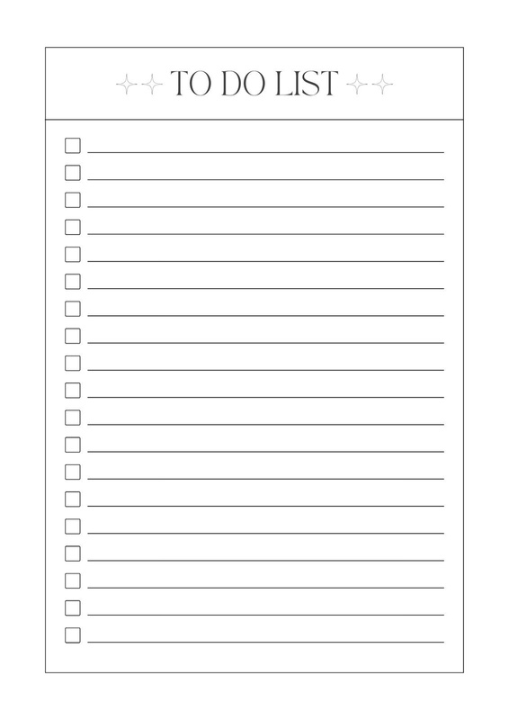
Introduction
A to-do list is a valuable tool that helps individuals organize work and projects, prioritize tasks, stay focused, manage time effectively, and track progress. Whether digital or physical, a well-crafted to-do list enables you to streamline your workflow, boost productivity, and achieve your goals.

Slide 3

Project Goals
The goal of this project is to create a comprehensive and organized system for managing tasks and activities, utilizing a to-do list to enhance productivity, streamline workflow, and achieve specific objectives, ultimately driving success and efficiency.

Slide 4
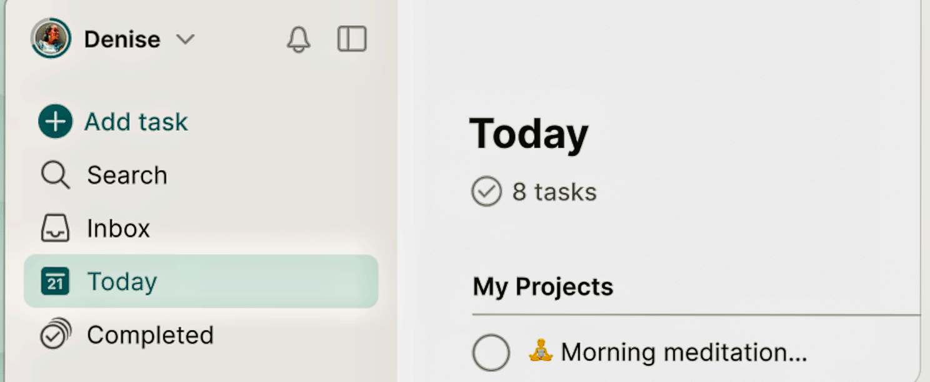
System Design
User Interface

Slide 5
System Design
A to-do list user interface typically includes:
1. Task input field
2. Task list display
3. Priority indicators (e.g., high, medium, low)
4. Due date/calendar integration
5. Task status indicators (e.g., completed, pending)
6. Editing and deletion options
7. Organization features (e.g., categories, tags)
A well-designed UI should be intuitive, visually appealing, and easy to navigate, making it simple for users to manage their tasks efficiently.

Slide 6
Implementation Details
1. Task creation: Implement a form to capture task details, such as title, description, due date, and priority.
2. Task listing:Display tasks in a list or grid, with options for filtering, sorting, and pagination.
3. Task editing: Allow users to update task details, such as title, description, or due date.
4. Task deletion: Implement a delete button or option to remove tasks from the list.
5. Due date/calendar integration:Use a library like FullCalendar or DatePicker to handle due date selection and display.
6. Priority indicators: Use colors, icons, or labels to visually indicate task priorities.
7. Task status indicators: Display task status, such as completed or pending, using checkboxes, labels, or icons.

Slide 7
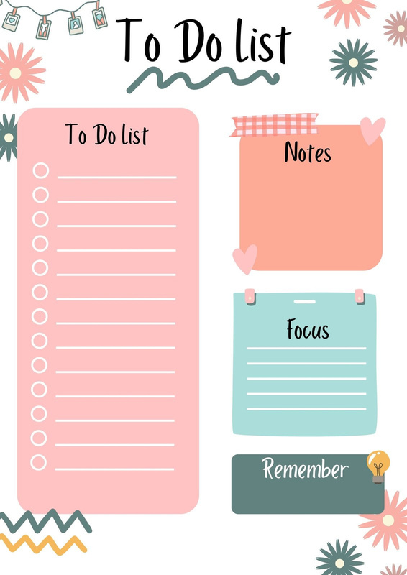
Advantages
1. Improved organization: Helps prioritize tasks and manage time effectively.
2. Increased productivity: Breaks down large tasks into smaller, manageable chunks.
3. Reduced stress: Provides a clear plan and sense of control.
4. Better time management: Enables users to focus on important tasks.
5. Enhanced accountability: Helps track progress and stay on track.

Slide 8

Challenges
1.Overwhelming: Long lists can be daunting and stressful.
2. Inflexibility: Rigid lists may not accommodate changing priorities.
3. Procrastination: Putting off tasks can lead to guilt and decreased motivation.
4. Perfectionism: Unrealistic expectations can lead to frustration.
5. Maintenance: Requires regular updates and maintenance.

Slide 9
Conclusion
In conclusion, a well-designed to-do list project can be a powerful tool for boosting productivity, reducing stress, and achieving goals. By understanding the benefits and challenges of to-do lists, individuals can create effective task management systems that help them stay organized, focused, and motivated. With the right approach, to-do lists can be a valuable asset for anyone looking to streamline their workflow and accomplish more.

Slide 10
Thank You

